Slide 1
Unit-2.4 Multiplexing
Prepared By:
Prof. Vishal A. Polara
Assistant Professor
Information Technology Department
Birla Vishvakarma Mahavidyalaya Engineering College

Slide 2
Bandwidth utilization is the wise use of available bandwidth to achieve specific goals.
Efficiency can be achieved by multiplexing; privacy and anti-jamming can be achieved by spreading.

Slide 3
Outline
1. Multiplexing
Frequency division multiplexing(FDM)
Wavelength division multiplexing(WDM)
Synchronous Time division Multiplexing(STDM)
Statistical Time division multiplexing
2. Spread Spectrum
Frequency Hopping Spread Spectrum(FHSS)
Direct Sequence Spread Spectrum(DSSS)

Slide 4
1. Multiplexing
Multiplexing is the set of techniques that allows the simultaneous transmission of multiple signals across a single data link.
Whenever the bandwidth of a medium linking two devices is greater than the bandwidth needs of the devices, the link can be shared. As data and telecommunications use increases, It increase traffic.
If the bandwidth of a link is greater than the bandwidth needs of the devices connected to it, the bandwidth is wasted.
In a multiplexed system n lines share the bandwidth of one link.
Here multiplexer is used at sender side to combine the signal and at receiver side demultiplexer is used to separate the signal.

Slide 5
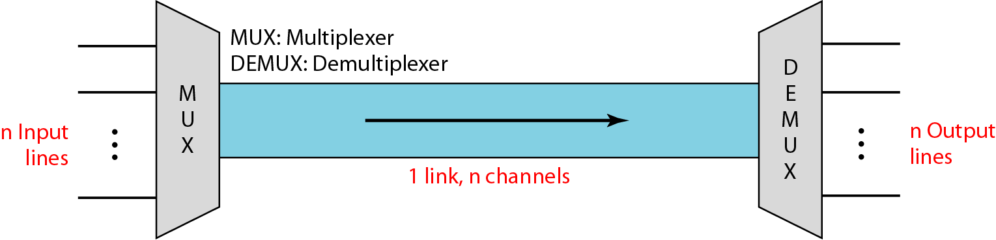
Figure Dividing a link into channels

Slide 6
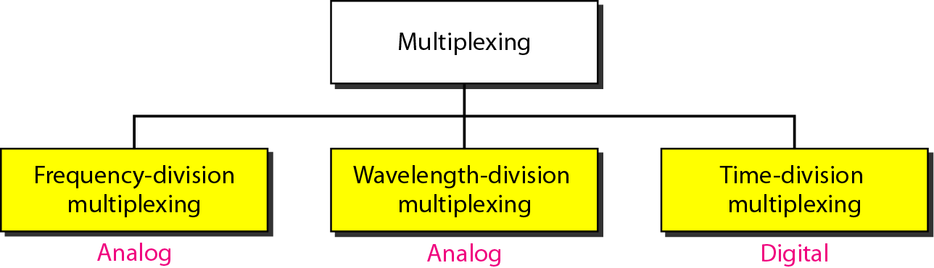
Figure Categories of multiplexing

Slide 7
1.1 Frequency division multiplexing(FDM)
It is an analog technique that can be applied when the bandwidth of a link is greater than the combined bandwidths of the signals to be transmitted.
In FDM signals generated by sending devices modulate at different carrier frequencies.
These modulated signal combined at transmitted across a link.
Carrier frequencies are separated by sufficient bandwidth to accommodate the modulated signal.
Here channel can be separated by strips of unused bandwidth called guard bands to prevent signals from overlapping.
It can also use for digital signal but it needs to be converted in analog before transmission.
It is used in AM and FM radio broadcasting and TV broadcasting (6MHz band each channel.)

Slide 8
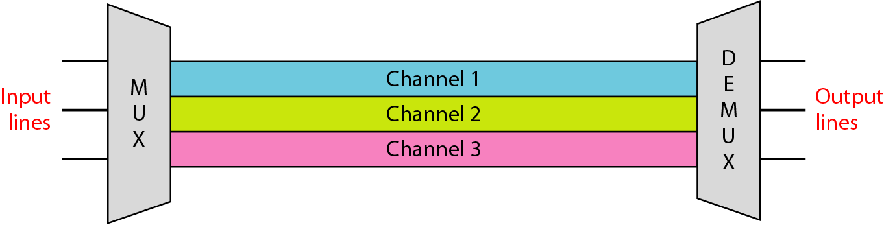
1. Frequency Division Multiplexing (FDM)
Figure Frequency-division multiplexing
FDM is an analog multiplexing technique that combines analog signals.

Slide 9
Multiplexer and demultiplexer
Multiplexer: Each source generates a signal of a similar frequency range.
Inside multiplexer these signal modulates different carrier frequencies.
Then all this signal combined into single composite signal that is sent over a link.
Demultiplexer: The demultiplexer uses a series of filters to decompose the multiplexed signal into its constituent component signals.
The individual signals are then passed to a demodulator that separates them from their carriers and passes them to the output lines.

Slide 10
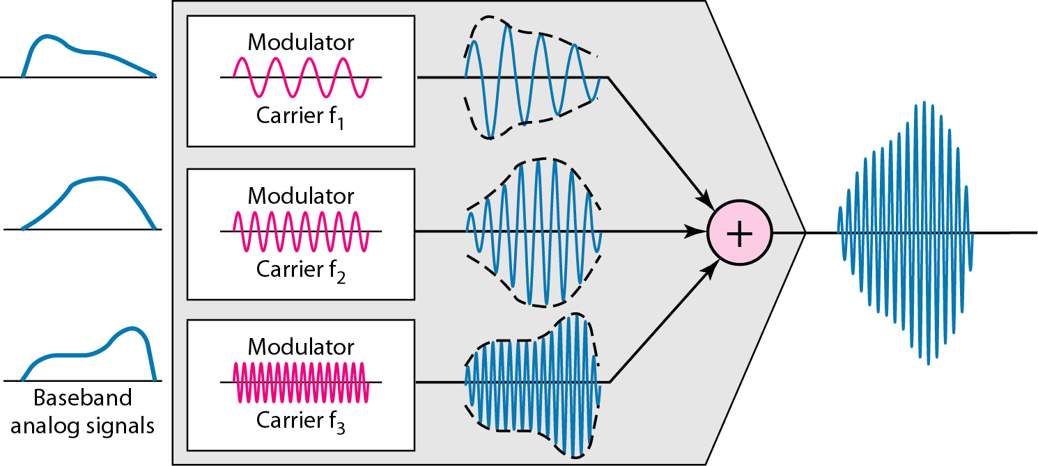
Figure FDM process

Slide 11
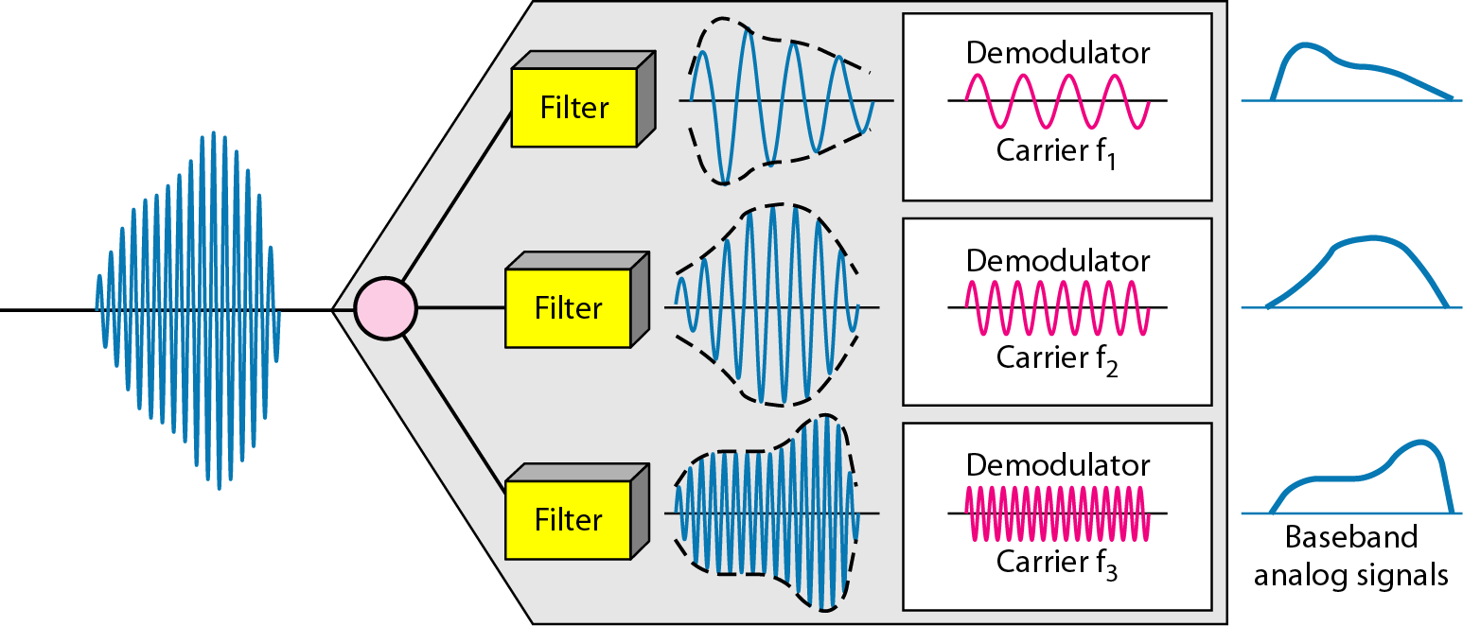
Figure FDM demultiplexing example

Slide 12
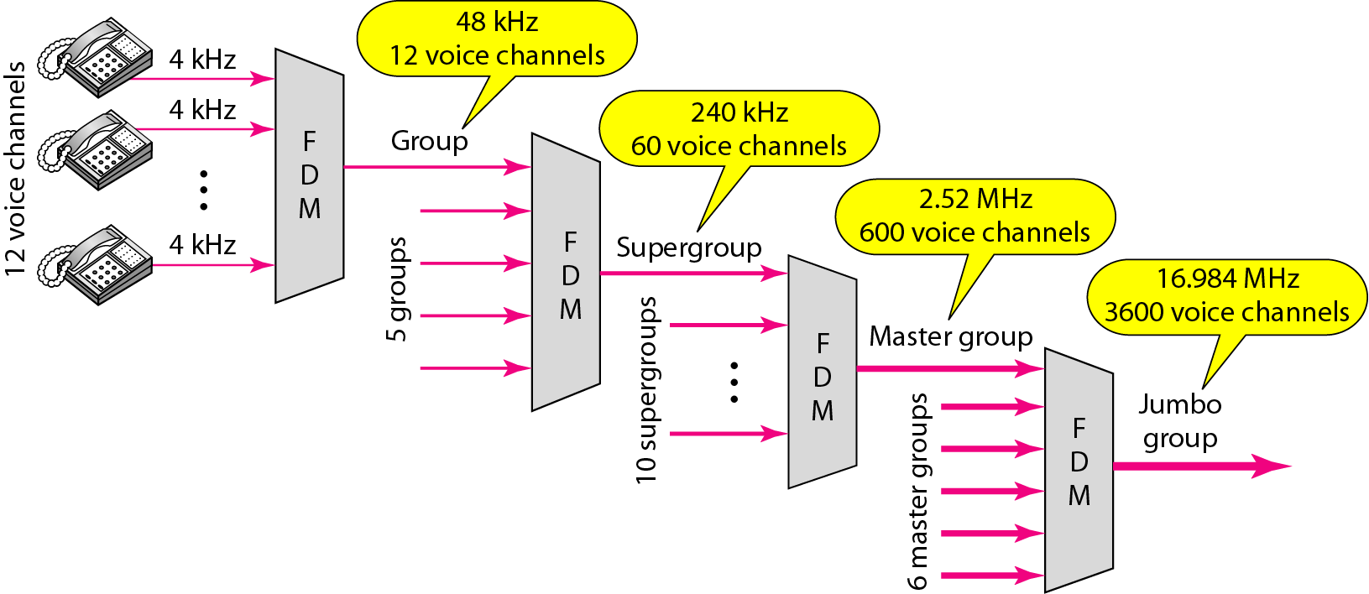
Figure Analog hierarchy

Slide 13
Example
Assume that a voice channel occupies a bandwidth of 4 kHz. We need to combine three voice channels into a link with a bandwidth of 12 kHz, from 20 to 32 kHz. Show the configuration, using the frequency domain. Assume there are no guard bands.
Solution
We shift (modulate) each of the three voice channels to a different bandwidth, We use the 20- to 24-kHz bandwidth for the first channel, the 24- to 28-kHz bandwidth for the second channel, and the 28- to 32-kHz bandwidth for the third one.

Slide 14
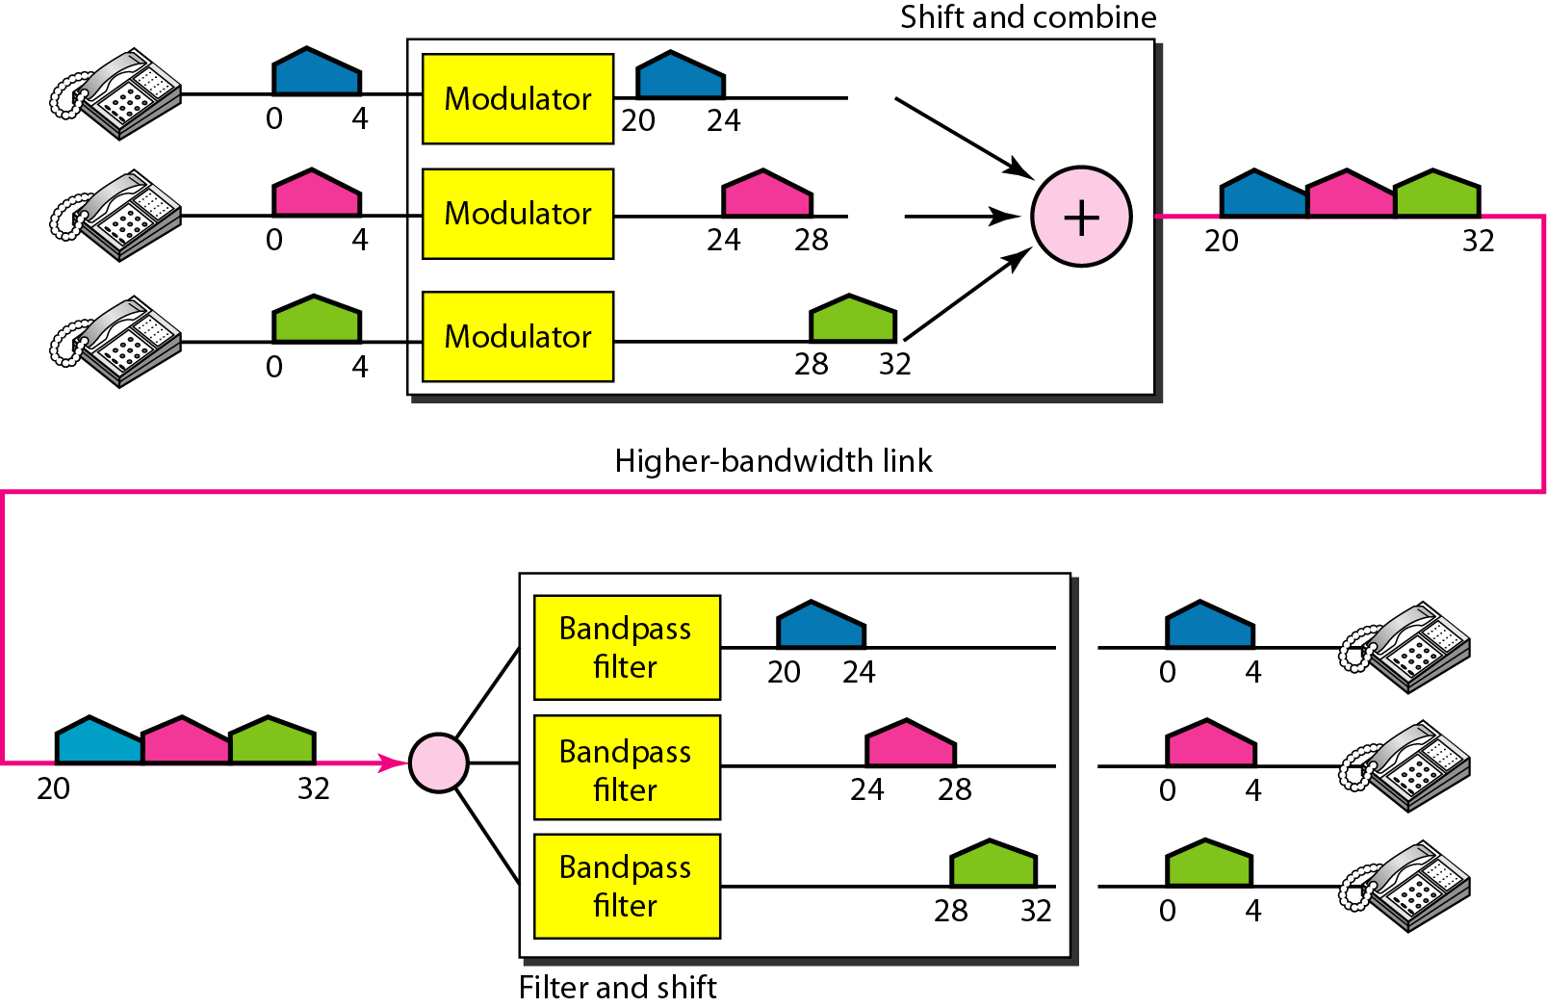
Figure

Slide 15
Example
Five channels, each with a 100-kHz bandwidth, are to be multiplexed together. What is the minimum bandwidth of the link if there is a need for a guard band of 10 kHz between the channels to prevent interference?
Solution
For five channels, we need at least four guard bands. This means that the required bandwidth is at least
5 × 100 + 4 × 10 = 540 kHz,

Slide 16
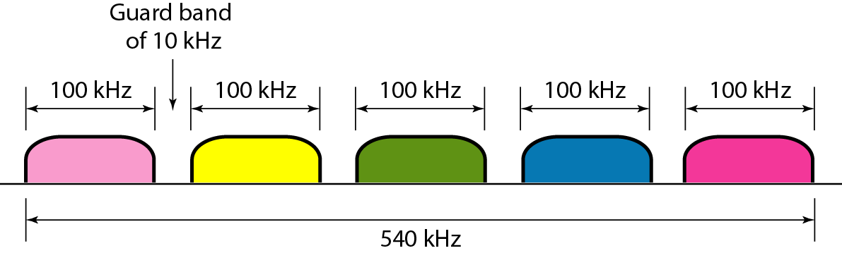
Figure

Slide 17
1.2 Wavelength division multiplexing(WDM)
It is designed to use the high data rate capability of fiber optic cable.
The optical fiber data rate is higher than the data rate of metallic transmission cable. So it is get wasted all the time.
Here multiplexing and demultiplexing of optical singles is done and the frequency is high than FDM signals.
In this technique very narrow bands of light from different sources are combined to make a wider band of light.
It is very complex technique but we can make it simple using prism to do multiplexing and de-multiplexing.
Prisms normally bands a beam of light based on the angle of incidence and the frequency.
A multiplexer combine input beam of narrow band of frequency into output beam of wider band of frequency. A de-multiplexer do the reverse process.
It is used in SONET network. Dense WDM combine very large number of channels by spacing channels very close to on another.

Slide 18
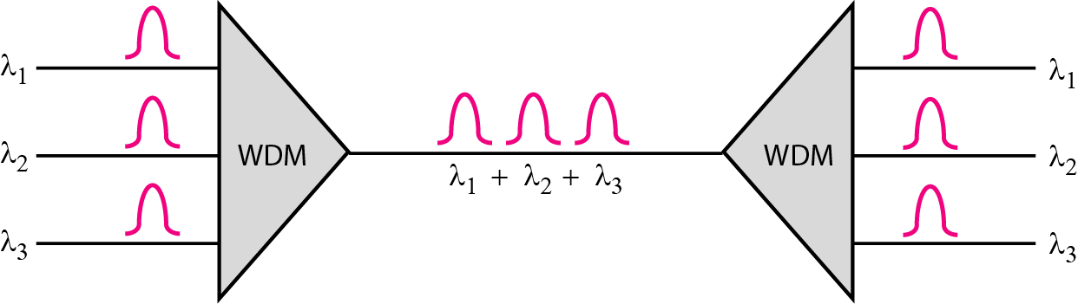
2. Wavelength Division Multiplexing (WDM)
Figure Wavelength-division multiplexing
WDM is an analog multiplexing technique to combine optical signals.

Slide 19
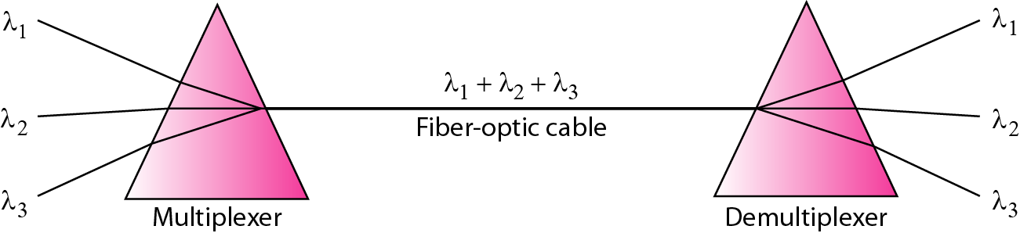
Figure Prisms in wavelength-division multiplexing and demultiplexing

Slide 20
1.3 Time division multiplexing(TDM)
It is a digital process that allows several connections to share the high bandwidth of a link.
Here time is shared instead of sharing portion of an bandwidth.
Each connection occupies a portion of time in the link.
All the data of message going from source 1 to specific destination be it 1,2,3 or 4. The delivery is fixed and unvarying, unlike switching.
In this technique digital data from different sources are combined into one timeshared link.
Here data must be digital.
It is divided into two different schemes: synchronous and statistical

Slide 21
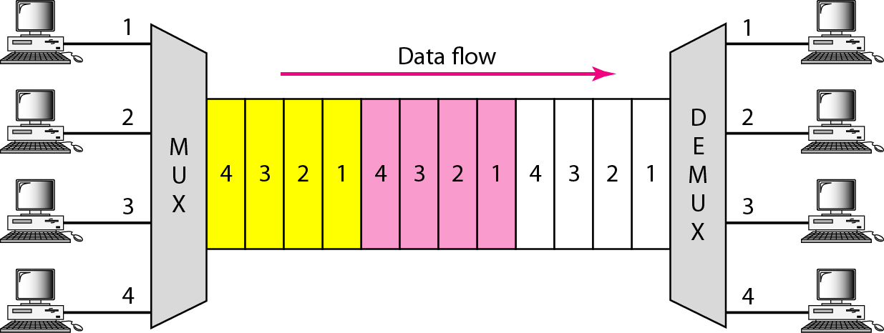
3. Time Division Multiplexing (TDM)
Figure TDM
TDM is a digital multiplexing technique for combining several low-rate channels into one high-rate one.

Slide 22
Time Division Multiplexing
Synchronous Time Division Multiplexing
Statistical Time Division Multiplexing

Slide 23
1.3.1 Synchronous Time- division multiplexing
In Synchronous TDM, each input connection has an allotment in the output even if it is not sending data.
The data flow of each input connection is divided into units, where each input occupies one input time slot.
A unit can be 1 bit, one character or one block of data.
1. time slot:
Based on each input there will be one output unit and time slot.
However duration of an output time slot is n times shorter than the duration of an input time slot. If the input time slot is Ts, output time slot is T/n s where n is number of connections.
If duration is shorter than it travels faster.
Here frame is created from data unit of each input connections.
If we have n connections a frame is divided into n time slots and one slot is allocated for each unit. One for each input line.

Slide 24
1.3.1 Synchronous Time- division multiplexing
Here duration of each frame is Ts.
The data rate of the output link must be n times the data rate of n connection to guarantee the flow of data.
In synchronous TDM, the data rate of the link is n times faster, and the unit duration is n times shorter.

Slide 25
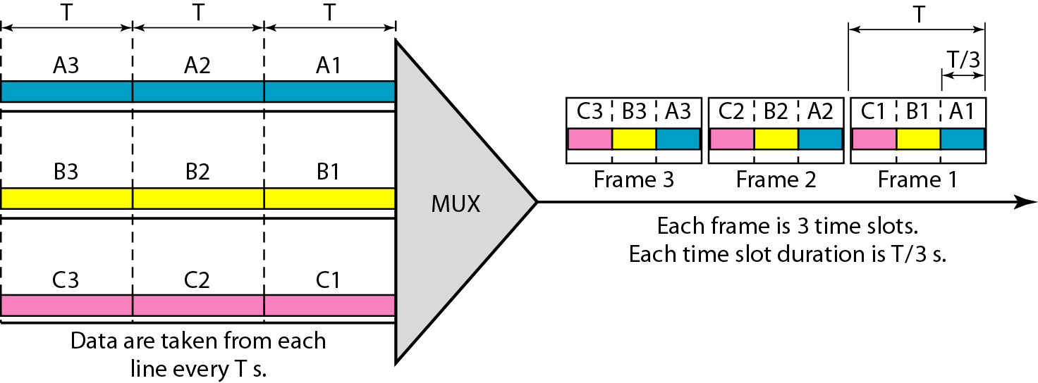
3.1 Synchronous Time Division Multiplexing (TDM)
Figure Synchronous time-division multiplexing
In synchronous TDM, the data rate of the link is n times faster, and the unit duration is n times shorter.

Slide 26
Example
the data rate for each input connection is 3 kbps. If 1 bit at a time is multiplexed (a unit is 1 bit), what is the duration of (a) each input slot, (b) each output slot, and (c) each frame?
Solution
We can answer the questions as follows:
a. The data rate of each input connection is 1 kbps. This means that the bit duration is 1/1000 s or 1 ms. The duration of the input time slot is 1 ms (same as bit duration).

Slide 27
Example(continued)
b. The duration of each output time slot is one-third of the input time slot. This means that the duration of the output time slot is 1/3 ms.
c. Each frame carries three output time slots. So the duration of a frame is 3 × 1/3 ms, or 1 ms. The duration of a frame is the same as the duration of an input unit.

Slide 28
Example
Figure shows synchronous TDM with a data stream for each input and one data stream for the output. The unit of data is 1 bit. Find (a) the input bit duration, (b) the output bit duration, (c) the output bit rate, and (d) the output frame rate.
Solution
We can answer the questions as follows:
a. The input bit duration is the inverse of the bit rate: 1/1 Mbps = 1 μs.
b. The output bit duration is one-fourth of the input bit duration, or ¼ μs.

Slide 29
Example (continued)
c. The output bit rate is the inverse of the output bit duration or 1/(4μs) or 4 Mbps. This can also be deduced from the fact that the output rate is 4 times as fast as any input rate; so the output rate = 4 × 1 Mbps = 4 Mbps.
d. The frame rate is always the same as any input rate. So the frame rate is 1,000,000 frames per second. Because we are sending 4 bits in each frame, we can verify the result of the previous question by multiplying the frame rate by the number of bits per frame.

Slide 30
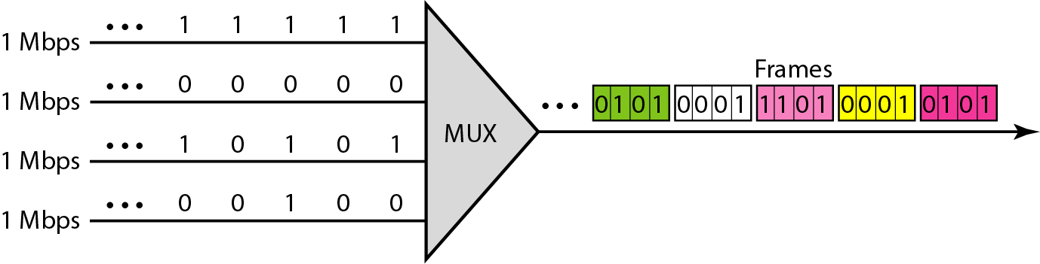
Figure

Slide 31
Example
Four 1-kbps connections are multiplexed together. A unit is 1 bit. Find (a) the duration of 1 bit before multiplexing, (b) the transmission rate of the link, (c) the duration of a time slot, and (d) the duration of a frame.
Solution
We can answer the questions as follows:
a. The duration of 1 bit before multiplexing is 1 / 1 kbps, or 0.001 s (1 ms).
b. The rate of the link is 4 times the rate of a connection, or 4 kbps.

Slide 32
Example (continued)
c. The duration of each time slot is one-fourth of the duration of each bit before multiplexing, or 1/4 ms or 250 μs. Note that we can also calculate this from the data rate of the link, 4 kbps. The bit duration is the inverse of the data rate, or 1/4 kbps or 250 μs.
d. The duration of a frame is always the same as the duration of a unit before multiplexing, or 1 ms. We can also calculate this in another way. Each frame in this case has four time slots. So the duration of a frame is 4 times 250 μs, or 1 ms.

Slide 33
1.3.1 Synchronous Time- division multiplexing
2. Interleaving:
It can be visualized as two fast rotating switches.
The switches are synchronized and rotate at the same speed but in opposite directions.
At multiplexing side it opens in front of a connection that connection has the opportunity to send a unit onto the path. It is called interleaving.

Slide 34
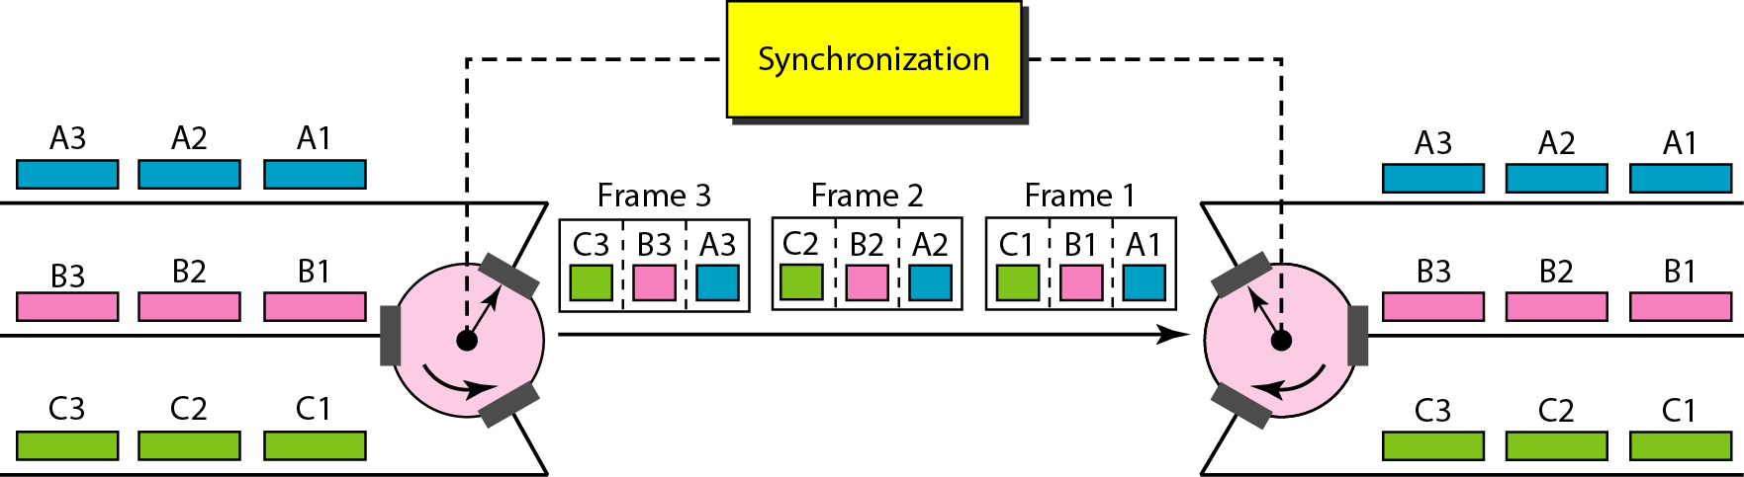
Figure Interleaving

Slide 35
Example
Four channels are multiplexed using TDM. If each channel sends 100 bytes /s and we multiplex 1 byte per channel, show the frame traveling on the link, the size of the frame, the duration of a frame, the frame rate, and the bit rate for the link.
Solution
Each frame carries 1 byte from each channel; the size of each frame, therefore, is 4 bytes, or 32 bits. Because each channel is sending 100 bytes/s and a frame carries 1 byte from each channel, the frame rate must be 100 frames per second. The bit rate is 100 × 32, or 3200 bps.

Slide 36
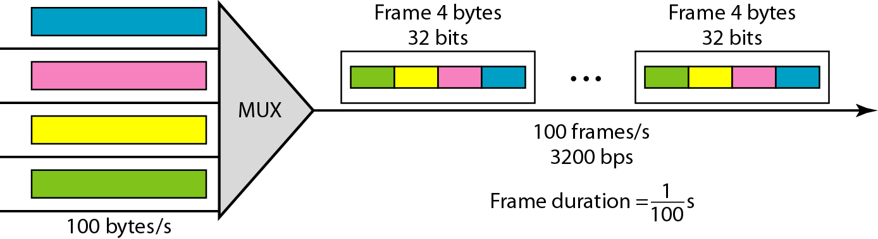
Figure

Slide 37
Example
A multiplexer combines four 100-kbps channels using a time slot of 2 bits. Show the output with four arbitrary inputs. What is the frame rate? What is the frame duration? What is the bit rate? What is the bit duration?
Solution
Figure shows the output for four arbitrary inputs. The link carries 50,000 frames per second. The frame duration is therefore 1/50,000 s or 20 μs. The frame rate is 50,000 frames per second, and each frame carries 8 bits; the bit rate is 50,000 × 8 = 400,000 bits or 400 kbps. The bit duration is 1/400,000 s, or 2.5 μs.

Slide 38
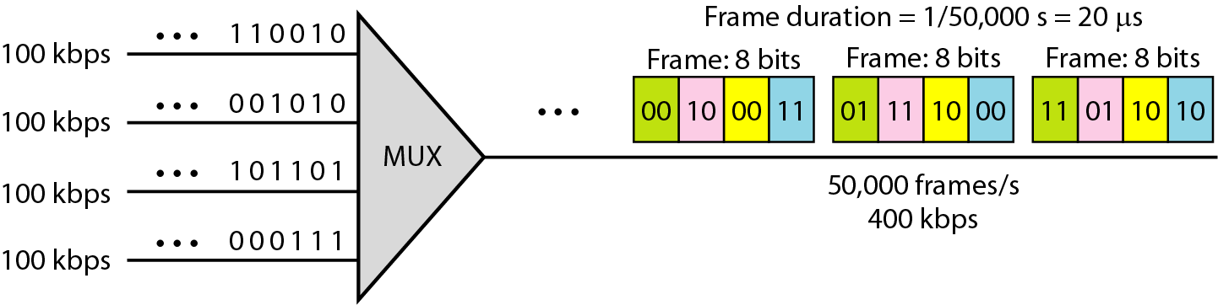
Figure

Slide 39
1.3.1 Synchronous Time- division multiplexing
3. Empty Slot:
It is not an efficient method.
If a source does not have data to send the corresponding slot in the output frame is empty.
In the fig show that first output frame has three slots filled, the second frame has two slots filled and the third frame has three slots filled. No frame is full.
Statistical TDM is used to improve this efficiency by removing empty slots from the frame.

Slide 40
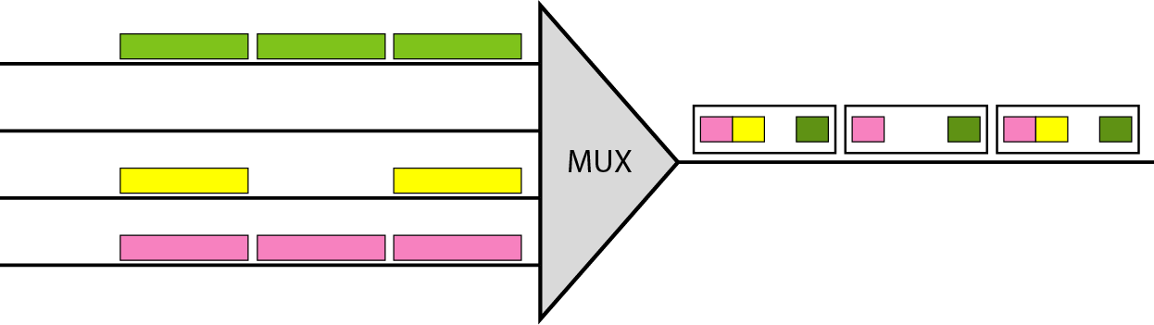
Figure Empty slots

Slide 41
1.3.1 Synchronous Time- division multiplexing
3. Data Rate Management:
There is a problem of disparity in the input data rates.
In our example we assume data rates of all line is same, if data rates are not the same. There are three strategies.
1. Multilevel Multiplexing:
- In Multilevel multiplexing data rate of an input line is a multiple of others.
2. Multiple slot allocation:
- It is a technique where two slot is assign to one input line.
3. Pulse stuffing:
It is used when first technique is not applied.
In this technique dummy data(dominant data) are added to input data with lower rates. This will increase their rates. This technique is called pulse stuffing, bit padding or bit stuffing.

Slide 42
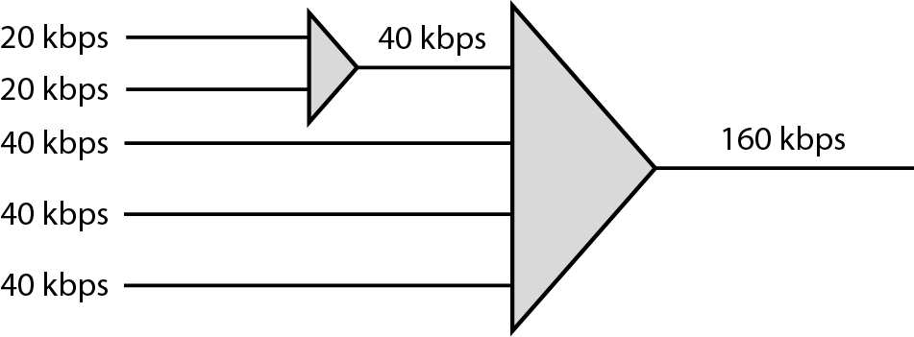
Data Rate Management
1. Multilevel multiplexing
Figure Multilevel multiplexing

Slide 43
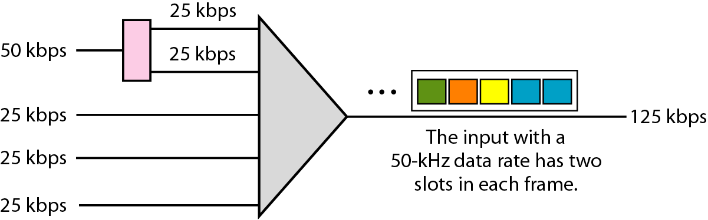
Data Rate Management
2. Multiple-slot multiplexing
Figure Multiple-slot multiplexing

Slide 44
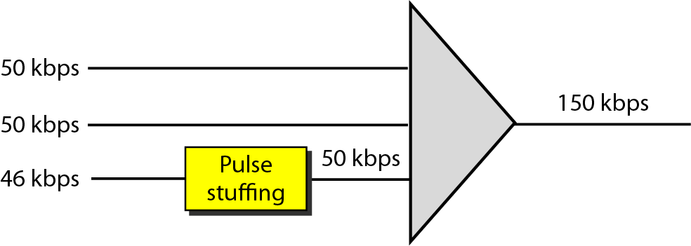
Data Rate Management
3. Pulse Stuffing
Figure Pulse stuffing

Slide 45
1.3.1 Synchronous Time- division multiplexing
Frame Synchronization:
In TDM synchronization is major issue.
To achieve synchronization a bits are usually added to the beginning of each frame. These bits called framing bits.
The demultiplexer follows the framing bits so that it can separate the time slots accurately.
In most of the case it consists of 1 bit per frame, alternating between 0 and 1.

Slide 46
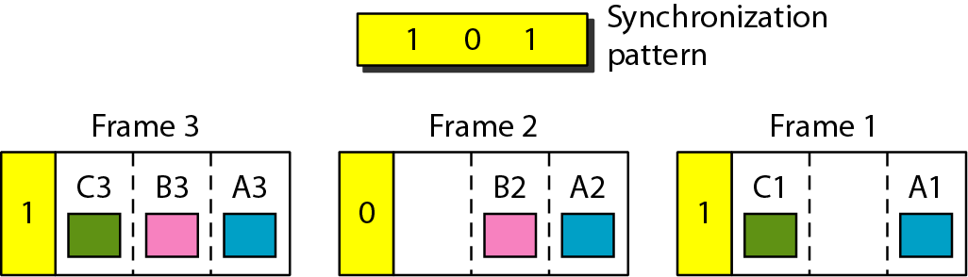
Framing Bits
Figure Framing bits

Slide 47
Example
We have four sources, each creating 250 characters per second. If the interleaved unit is a character and 1 synchronizing bit is added to each frame, find (a) the data rate of each source, (b) the duration of each character in each source, (c) the frame rate, (d) the duration of each frame, (e) the number of bits in each frame, and (f) the data rate of the link.
Solution
We can answer the questions as follows:
a. The data rate of each source is 250 × 8 = 2000 bps = 2 kbps.

Slide 48
Example (continued)
b. Each source sends 250 characters per second; therefore, the duration of a character is 1/250 s, or 4 ms.
c. Each frame has one character from each source, which means the link needs to send 250 frames per second to keep the transmission rate of each source.
d. The duration of each frame is 1/250 s, or 4 ms. Note that the duration of each frame is the same as the duration of each character coming from each source.
e. Each frame carries 4 characters and 1 extra synchronizing bit. This means that each frame is 4 × 8 + 1 = 33 bits.

Slide 49
Example
Two channels, one with a bit rate of 100 kbps and another with a bit rate of 200 kbps, are to be multiplexed. How this can be achieved? What is the frame rate? What is the frame duration? What is the bit rate of the link?
Solution
We can allocate one slot to the first channel and two slots to the second channel. Each frame carries 3 bits. The frame rate is 100,000 frames per second because it carries 1 bit from the first channel. The bit rate is 100,000 frames/s × 3 bits per frame, or 300 kbps.

Slide 50
1.3.2 Statistical Time- division multiplexing
In statistical time division multiplexing slots are dynamically allocated to improve bandwidth efficiency instead of fixed in synchronous TDM.
Here only when an input line has a slot’s worth of data to send is it given a slot in the output frame.
In this technique the number of slots in each frame is less than the number of input lines.
The multiplexer checks each input line in round robin fashion, it allocates a slot for an input line if the line has data to send otherwise it skips the line and checks the next line.

Slide 51
1.3.2 Statistical Time- division multiplexing
1. Addressing:
An output slot in synchronous TDM is totally occupied by data where in statistical TDM a slot needs to carry data as well as the address of the destination.
In synchronous TDM no need for addressing, it is done using predefined relationship between the input and output serve as an address.
In Statistical it is required to add address of the receiver inside each slot to show where it is to be delivered.
It is simplest form can be n bits to define N different output lines with n=log2N. For ex eight different output lines need 3 bit address.

Slide 52
1.3.2 Statistical Time- division multiplexing
Slot Size:
It must be reasonable to make transmission efficient. So 1 bit can not be send with three bit address.
No synchronization bit:
There are another difference between this two techniques.
At frame level Statistical TDM need not to be synchronized so we do not need synchronization bits.
Bandwidth:
In Statistical TDM the capacity of the link is normally less than the sum of the capacity of each channel.
Capacity of the channel is based on the statistics of the load for each channel.
-

Slide 53
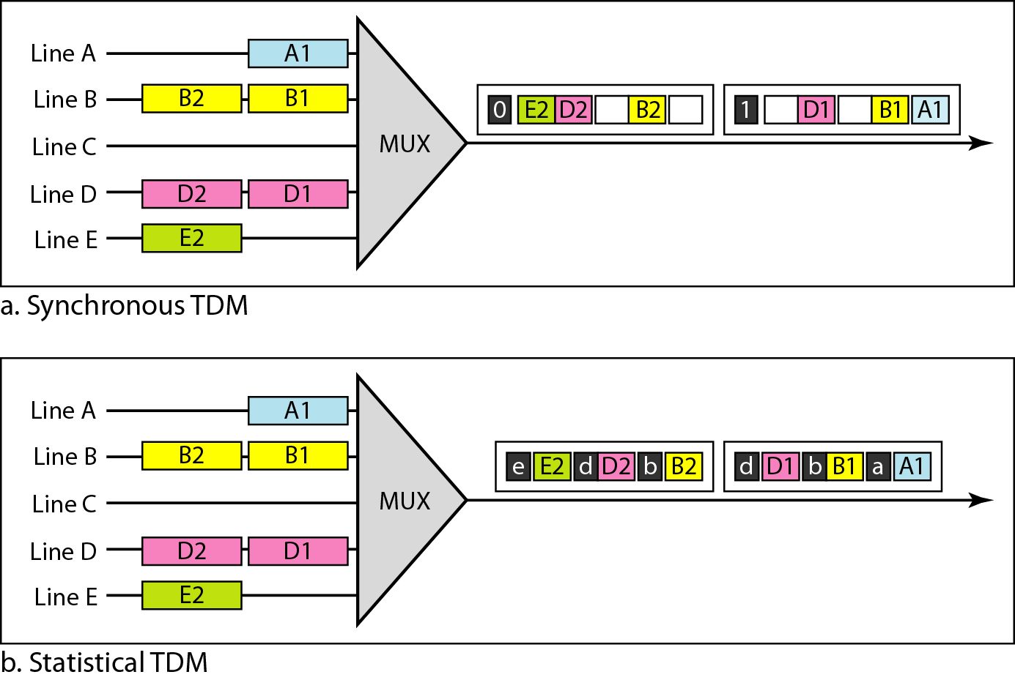
3.2 Statistical Time Division Multiplexing (TDM)
Figure TDM slot comparison

Slide 54
2. Spread Spectrum
Spread Spectrum technique is used to prevent eavesdropping and jamming this can be done by adding redundancy in information.
In Spread Spectrum technique medium is wireless(LAN or WAN), all station use air as a medium.
In Spread Spectrum the original spectrum spread for each station.
If the require bandwidth for each station is B, spread spectrum expands it to Bss, such that Bss>>B.
It allows source to wrap its message in protective envelope for a more secure transmission. For example special gift packing.
It works on Two principles:
The bandwidth allocated to each station needs to be larger than what is needed. This allow redundancy.
The expanding of the original bandwidth B to the bandwidth Bss must be done by a process that is independent of the original signal.
-

Slide 55
2. Spread Spectrum
The spreading process occurs after the signal is created by the source.
After signal is created by the source the spreading process uses a spreading code and spreads the bandwidth.
The spreading code is nothing but a series of numbers that look random, but are actually a pattern.
There are two techniques to spread bandwidth:
Frequency hopping spread spectrum(FHSS)
Direct sequence spread spectrum(DSSS)
-

Slide 56
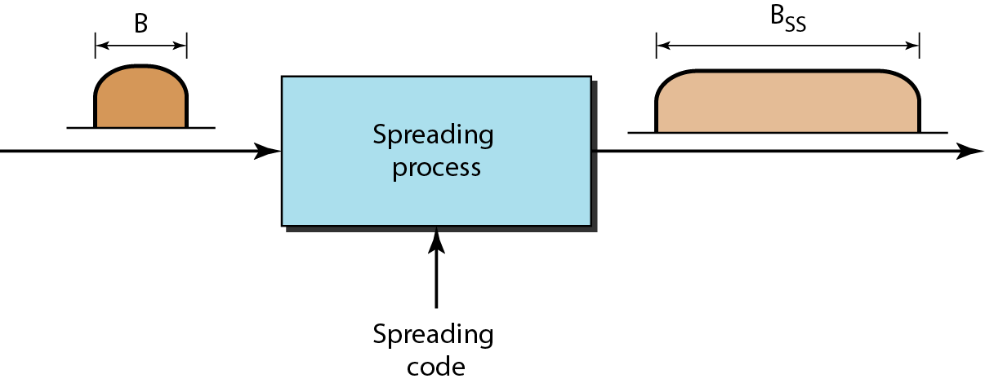
Figure Spread spectrum

Slide 57
2.1 Frequency hopping spread spectrum(FHSS)
FHSS techniques uses M different carrier frequencies that are modulated by the source signal.
Modulation of frequency is done one by one.
A pseudorandom code generator called pseudorandom noise(PN), creates a k-bit pattern for every hopping period Th.
The frequency table uses the pattern to find the frequency to be used for this hopping period and passes it to the frequency synthesizer.
The frequency synthesizer creates a carrier signal of that frequency and the source signal modulates the carrier signal.
Suppose we have decided to have eight hopping frequencies, The pseudorandom code generator will create eight different 3-bit patterns.
It is for all 8 period after completion of 8 period pattern get repeated.
-

Slide 58
2.1 Frequency hopping spread spectrum(FHSS)
Here if intruder tries to intercept the transmitted signal, he can only access a small piece of data it is difficult to know spreading sequence.
It also have anti-jamming effect. A malicious sender may be able to send noise to jam the signal for one hopping period but not for the whole period.
-

Slide 59
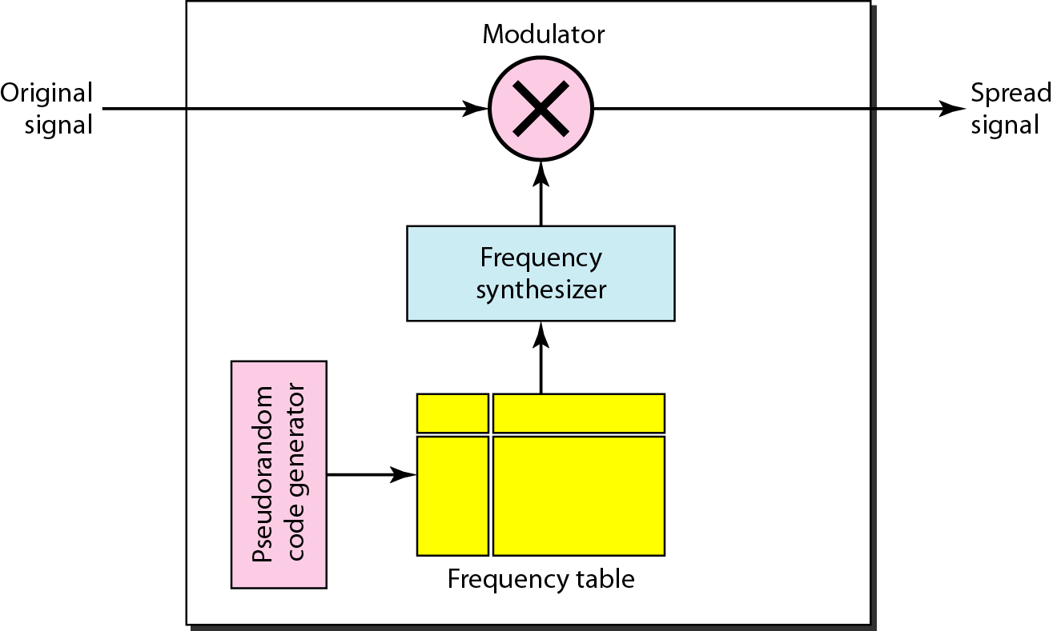
1. Frequency Hopping Spread Spectrum (FHSS)
Figure Frequency hopping spread spectrum (FHSS)

Slide 60
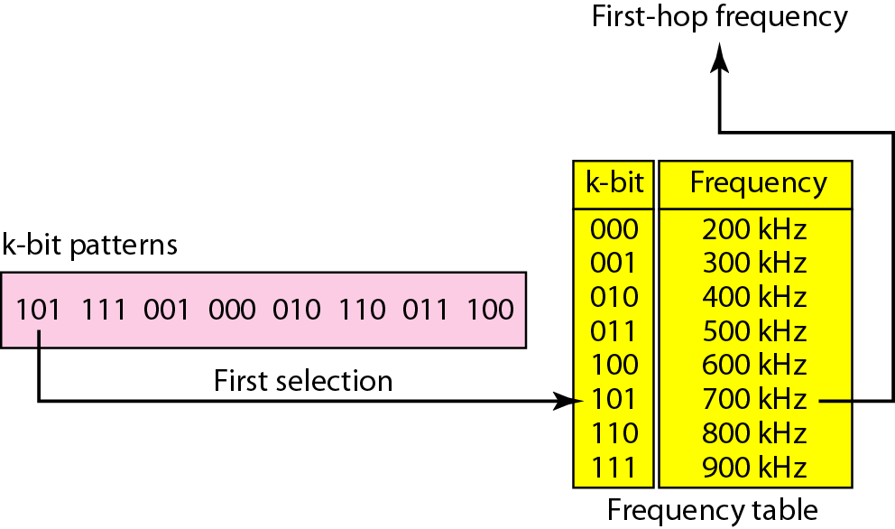
Figure Frequency selection in FHSS

Slide 61
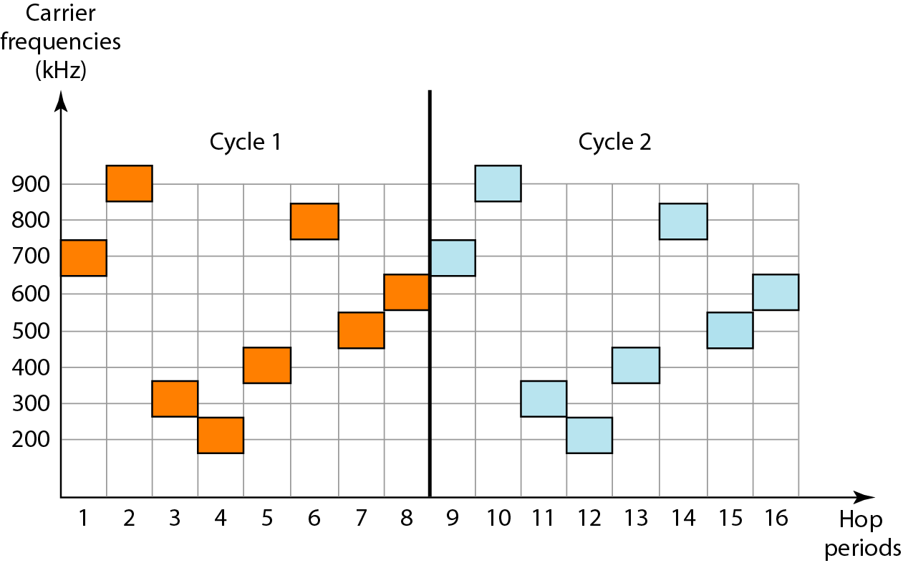
Figure FHSS cycles

Slide 62
2.1 Frequency hopping spread spectrum(FHSS)
Bandwidth Sharing:
If the number of hopping frequencies is M, we can multiplex M channels into one by using the same Bss bandwidth.
It is possible because station uses just one frequency in each hopping period, M-1 other frequencies can be use dy other M-1 stations.
M different station can uses same Bss if an appropriate modulation technique such as multiple FSK used.
In FHSS each station uses 1/M of the bandwidth but the allocation changes hop to hop. In FDM allocation is fixed.

Slide 63
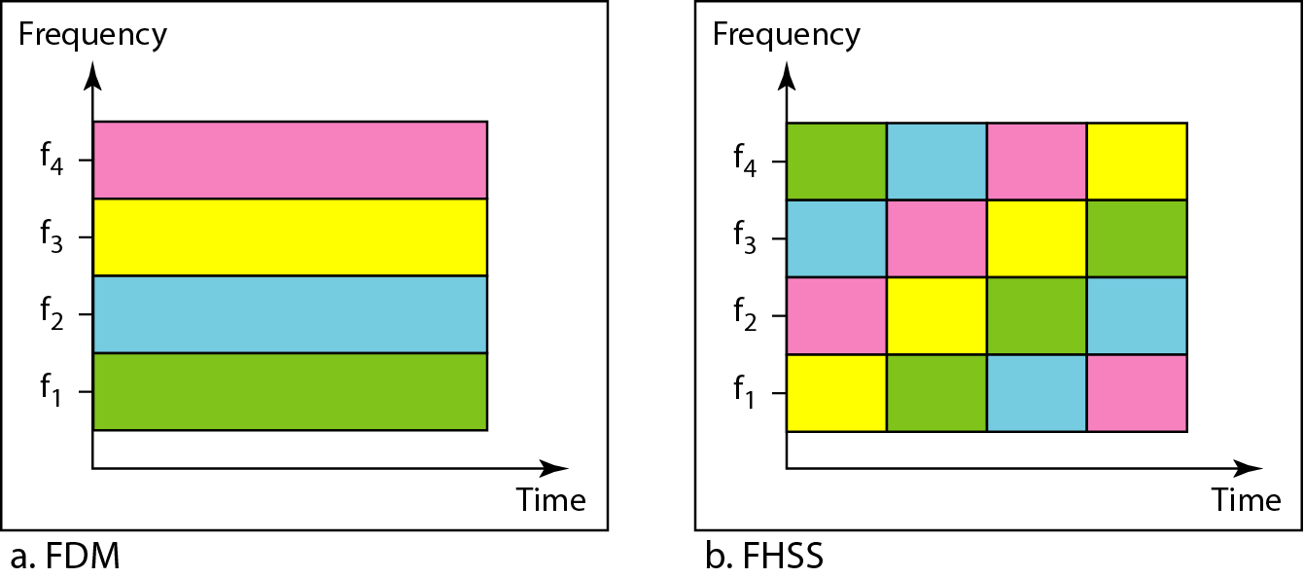
Figure Bandwidth sharing

Slide 64
2.2 Direct Sequence spread spectrum(FHSS)
In DSSS we replace each data bit with n bits using a spreading code.
Each bit is assigned a code of n bits called chips, where the chip rate is n times that of the data bit.
It is also expand the original signal but the process is different.
For Example sequence used in a wireless LAN the famous barker sequence where n is 11.
If the original signal rate is N, the rate of the spread signal is 11N.
This means that the required bandwidth for the spread signal is 11 times larger than the bandwidth of the original signal.
The spread signal can provide privacy if the intruder does not know the code.
It can also provide immunity against interference if each station uses a different code.

Slide 65
2.2 Direct Sequence spread spectrum(FHSS)
Bandwidth Sharing:
If we use a spreading code that spreads signals that cannot be combined and separated we cannot share a bandwidth.
In some wireless LANs use DSSS and the spread bandwidth cannot be shared.
If we use special type of sequence code that allows the combining and separating of spread signals we can share the bandwidth.
For example cellular telephony and share a bandwidth between several users.

Slide 66
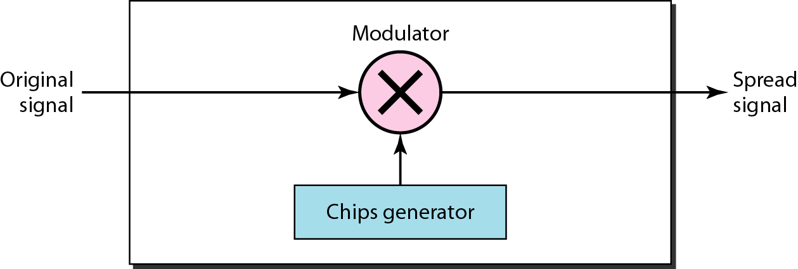
2. Direct Sequence Spread Spectrum (DSSS)
Figure DSSS

Slide 67
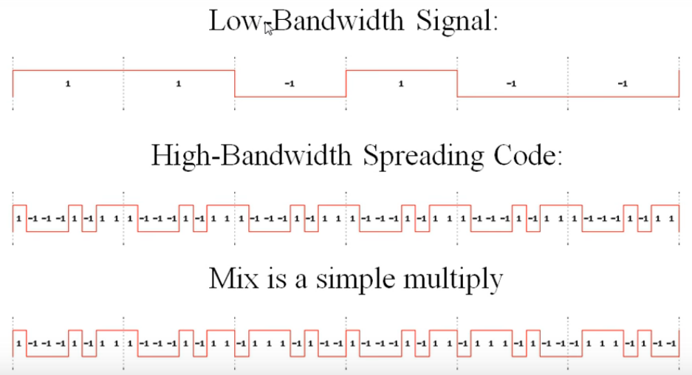
2.2 Direct Sequence spread spectrum(FHSS)
In this example for 0 we use -1 and for 1 we use 1 as spreading code in chip code.

Slide 68
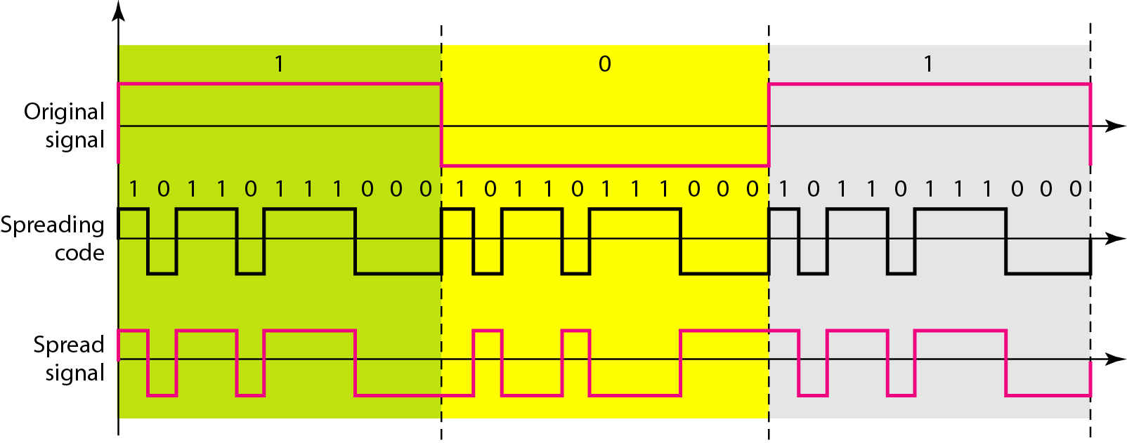
Figure DSSS example

Slide 69
Thank You

